Slide 1
Kaushal Panjee
Skill Register
End-to-end mobilization tool for DDUGKY and RSETI

Slide 2
Objectives
Collect information of “interested” candidates and do aspiration mapping (Youth Database in DDUGKY)
PIA tagging interesting candidates to MPR Batches.
Send SMS/Call interested candidates for Training, Camps, Job Melas by State/PIA.
Incentive Management for GRP/SHG/JRP structures. Who referred which candidate and where is he/she in the pipeline.
Reports to assess GP Saturation, list auto-inclusion families, show village wise deprivation levels for planning through SECC etc.
Host Job Role specific videos (being developed by MORD)
Followed up with an Android Application.

Slide 3
Users
CSC Centres
Block Officers
SRLM/State team
PIA Training Centre Team
Candidate

Slide 4



Input Mechanisms
State officials registering candidates in camp/block office/GP office with internet enabled computers/phones
PIA directly registering candidates.
CRP/SHG/JRP etc registering through Android Application
Candidates directly registering themselves.
Multi-Platform

Slide 5
One Single Form
Pre-populated with SECC Database.
User needs to find himself in SECC by entering first 2-3 characters of his name.
If User’s name is found, it lists down Father and Mothers Name.
If they also match, that means User correctly found!
But it’s not mandatory to find someone in the SECC database to be able to register themselves.

Slide 6
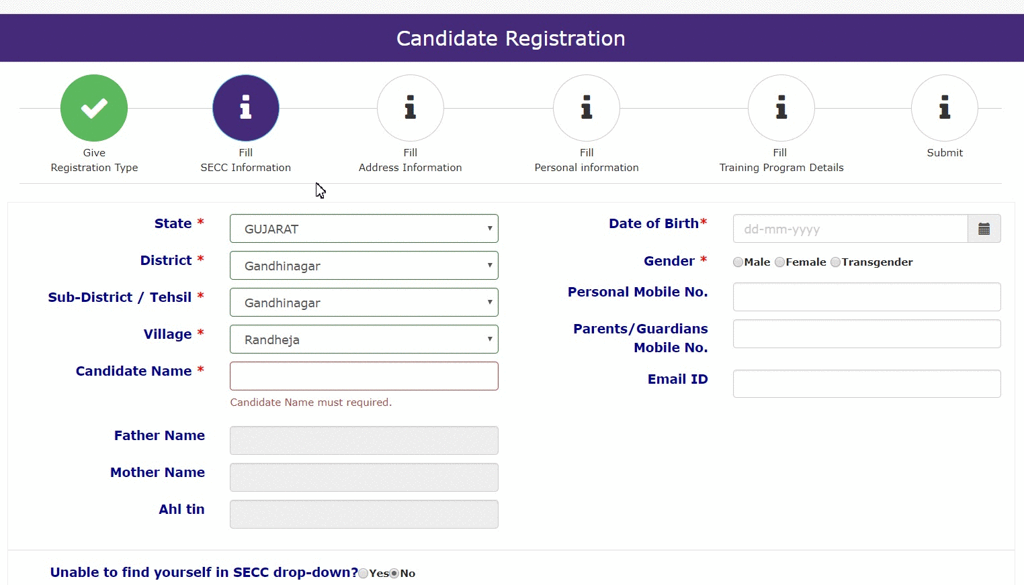

Slide 7
SECC Based Form
User fills in State -> District -> Tehsil -> Village
All the SECC names from the village are populated.
User enters first 2-3 characters of the candidate standing being registered.
Dropdown appears with people with the same first 2-3 characters.
If the User is found – he/she is selected and it loads up fathers name, mothers name and AHL TIN.
Please confirm if father/mother name matches and person is correctly selected and not someone else with same name.
If the User is not found → Press Yes to “Unable to find in SECC”
This opens up the fields for free entry of the candidates details.
It’s not mandatory to find someone in the SECC database to be able to register themselves.

Slide 8



Case 1 – Name is found and father and mother’s name matches
My name is Harpreet Singh from Village Rampur
Let me type H-A-R in the form.
Found it!
Is your Father’s Name Khushwant Singh and Mother’s Name Bela Singh?
Yes Sir, that is the name of my parents.
Great! Let’s proceed with the remaining form.

Slide 9
Case 2 – Name is found and father and mother’s name DOESN’T matches
My name is Harpreet Singh from Village Rampur
Let me type H-A-R in the form.
Found it!
Is your Father’s Name Khushwant Singh and Mother’s Name Bela Singh?
No Sir, that’s a different Harpreet Singh.
Oh! Let me try the other Harpreet from the dropdown.
Try with different Harpreet, if it still doesn’t match – Press Unable to find in SECC.

Slide 10
Case 3 – Name is not found as there is spelling mistake
My name is Meenal Singh from Village Rampur
Let me type M-E-E in the form.
Sorry MEENAL, I can’t find you in the list. How is your name spelt?
Sir, Please try MINAL
Oh! Let me try.. M-I-N
Ah! Found a Minal Singh! ☺
It’s a good thing to try spelling variations!

Slide 11
Case 4 – Name is not found in particular Village
Let me type C-H-A in the form.
Sorry Chandra, I can’t find you in the list.
Were you in Rampur during 2011-2012?
My name is Chandra Singh from Village Rampur
No Sir, I was in Village Aligarh.
Oh! Let me change the village to Aligarh and type C-H-A.
Found you!
SECC was collected around 2011 and if the candidate has moved ask him which village his house was in 2011.

Slide 12
Case 5 – Name is not found in SECC database
Let me type B-E-L in the form.
Sorry BELA, I can’t find you in the list.
My name is Bela Singh from Village Rampur
Sir, what to do? ☹
Don’t worry at all! Let me select “Unable to find in SECC”
Please tell me your name, father’s name and mother’s name ☺
After trying for different spellings and common mistakes and still not finding Bela – you can register her by pressing “YES” to unable to find in SECC.

Slide 13
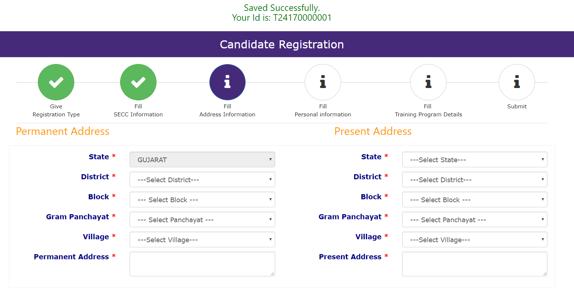

Slide 14
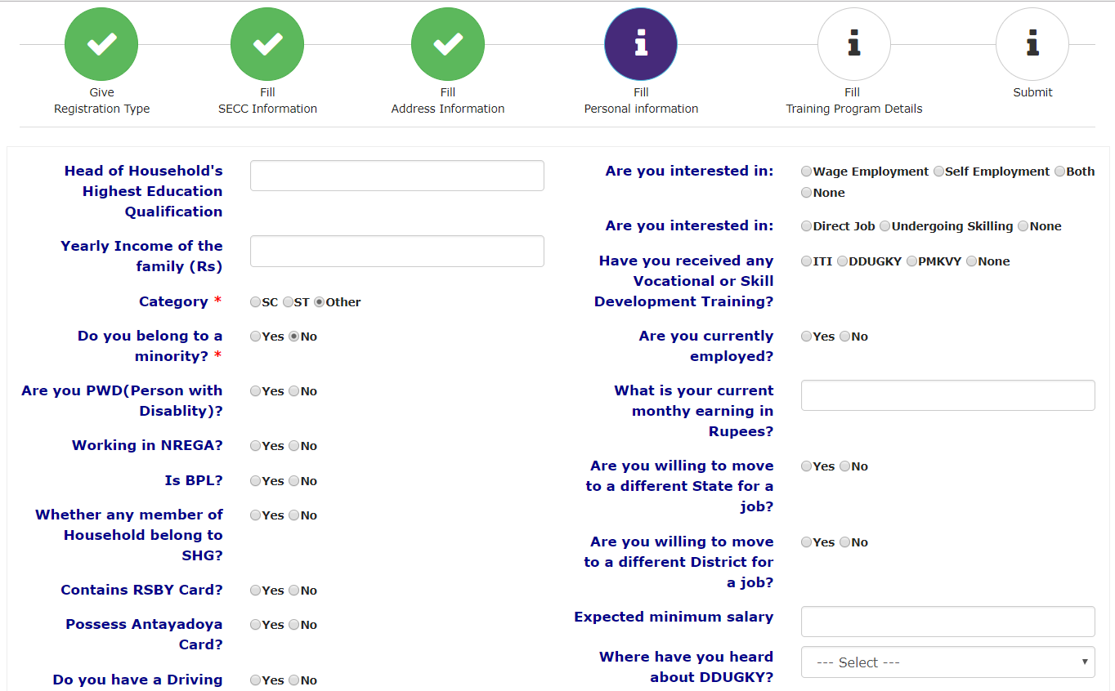

Slide 15
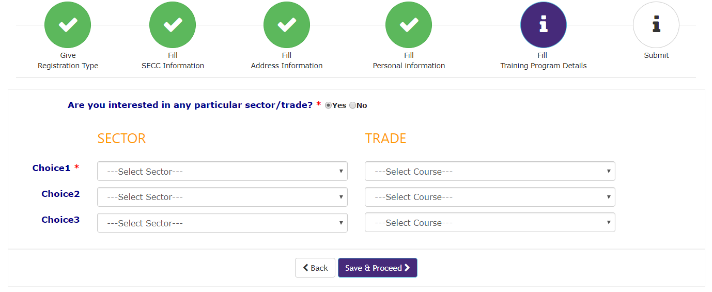

Slide 16
Types of Registration
Website
User fills physical form and it’s digitized on Kaushal Panjee through State Login.
User fills form public available without login – OTP will be sent to the mobile number at the end of the registration.
User is registered through State/District/Block/GP login – No OTP is sent.
App
Field Functionaries register people through the App in internet connected areas. OTP is sent and hence user has to be present.
Paper
In case internet connectivity fails, users can be registered through printed version of the form.

Slide 17
Android Application
Primary User: Door to Door CRP/SHG/JRP mobilizers.
Will contain DDUGKY IEC videos on scheme, job roles and success stories.
Form to enrol interested candidates.
Map to show existing training centers in District.
Same form as that available on the website.

Slide 18

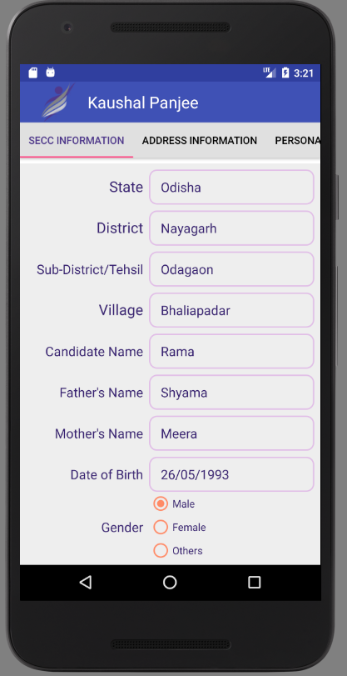
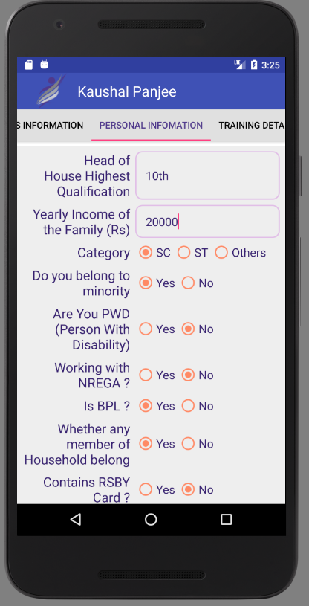
Android Application

Slide 19
Incase of Issues
If the website or application don’t work in unforeseen circumstances please carry physical versions of the form as distributed by MORD.
Ensure User fills all the entries in the physical form as the online form has many validations.
Keep multiple forms in handy always.

Slide 20
Pakwada 1st to 15th September
DDUGKY/RSETI Targets (copy from the letter that went from RISHI)
Installing of Application on SRLM tablets or phones of mobilizers.
Training Data Entry Operators for Mobilization Camps to directly register people on website.

Slide 21
Pakwada 1st to 15th September
Creating logins and passwords for your officials for each camp if not already created.
Mobilize ground force during these 15 days for maximum data collection and mobilization camp.
Test the webform/application before the final week.
Setup whatsapp group of field functionaries to communicate issues/updates in website and app.

Slide 22
Thank you!

